Slide 1
Mechanisms of Action of Bcl6
in Tfh Differentiation and Function
IMVC U19 Retreat
10/12/2018
Jinyong Choi
Crotty Lab

Slide 2
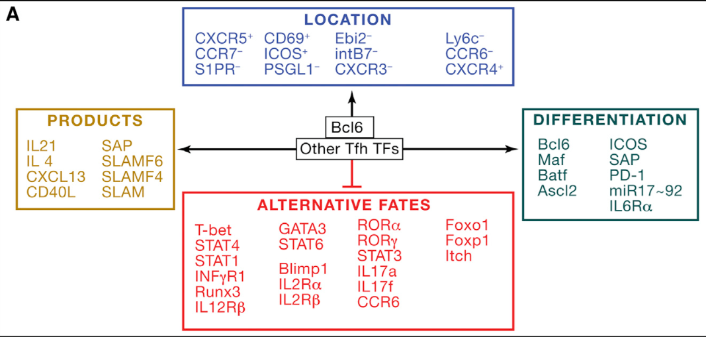
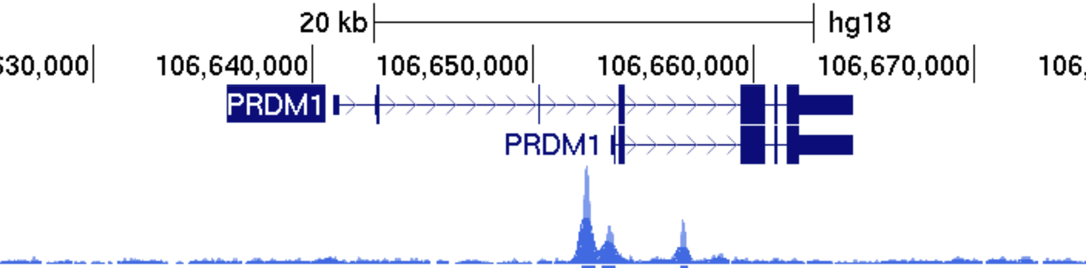
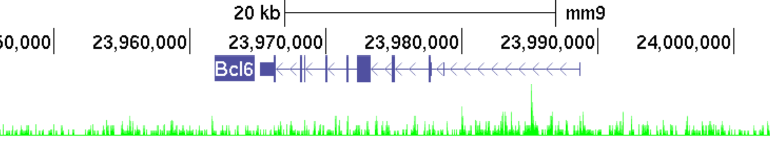
Regulation of Tfh Differentiation by Bcl6
Bcl6 is a lineage defining transcription factor in Tfh differentiation.
Bcl6 appears to be an obligate repressor.
Blimp1, encoded by Prdm1 gene, is a critical antagonist of Tfh differentiation.
Blimp1
Prdm1
Bcl6
Bcl6
Bcl6 Binding
Blimp1 binding
Crotty, 2014 Immunity. 41:529–542
Johnston, et al., 2009 Science, 325: 1006–1010
Nurieva, et al., 2009 Science, 325: 1001–1005
Yu, et al., 2009 Immunity, 31: 457–468
Notes:
Bcl6 plays a central role in directing Tfh diff.
Controls expression of 4 major categories of genes: cell migration, Tfh differentiation, Tfh products and alternative fates

Slide 3
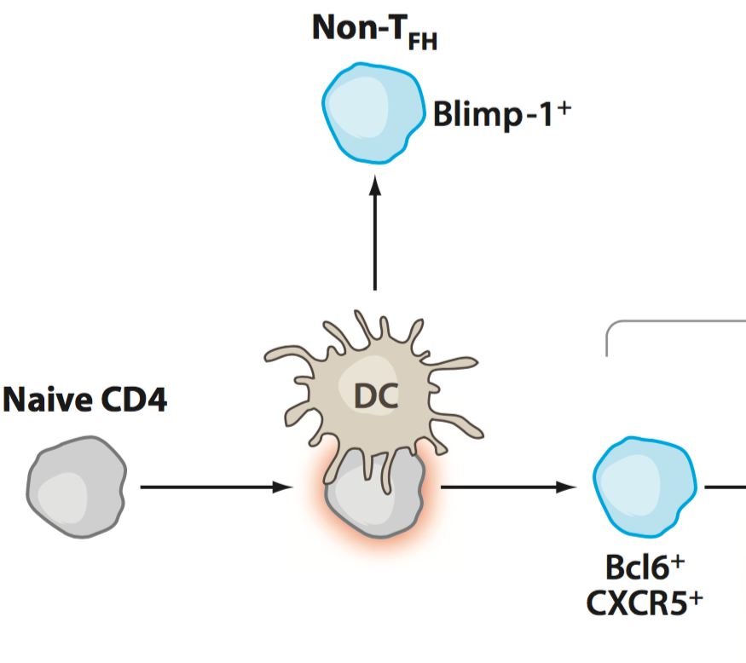
Tfh Differentiation Model in the Context of Gene Regulation by Bcl6
1. Is Tfh differentiation a default pathway for activated CD4 T cells?
Bcl6
Blimp1
Activated
CD4
Tfh
Crotty, 2011 Ann Rev Immunol, 29:621-63
Hypothesis:
If the Tfh differentiation is a default setting in activated CD4 T cells, CD4 T cells will differentiate to Tfh in the absence of Bcl6 and Blimp1.

Slide 4

Effect of Bcl6 / Prdm1 Combined Deficiency on Tfh Differentiation
SMARTA Cd4-Cre⁺ CD45.1⁺
Analysis
1. WT
2. Bcl6^{f/f}
3. Prdm1^{f/f}
4. Bcl6^{f/f}Prdm1^{f/f}
cells
KLH-gp₆₁
recipient
WT B6
d-1
d0
d8
WT
Bcl6^{f/f}
Prdm1^{f/f}
Bcl6^{f/f} Prdm1^{f/f}
CXCR5^{hi} SLAM^{lo} Tfh
WT
**
Bcl6^{f/f}
Prdm1^{f/f}
SLAM
Bcl6^{f/f}Prdm1^{f/f}
CXCR5^{hi} PSGL-1^{lo} GC Tfh
**
PSGL-1
CXCR5^{hi} PD1^{hi} GC Tfh
PD1
**
CXCR5
Bcl6^{f/f} Prdm1^{f/f} SMARTA cells failed to properly differentiate into Tfh and GC Tfh cells.

Slide 5
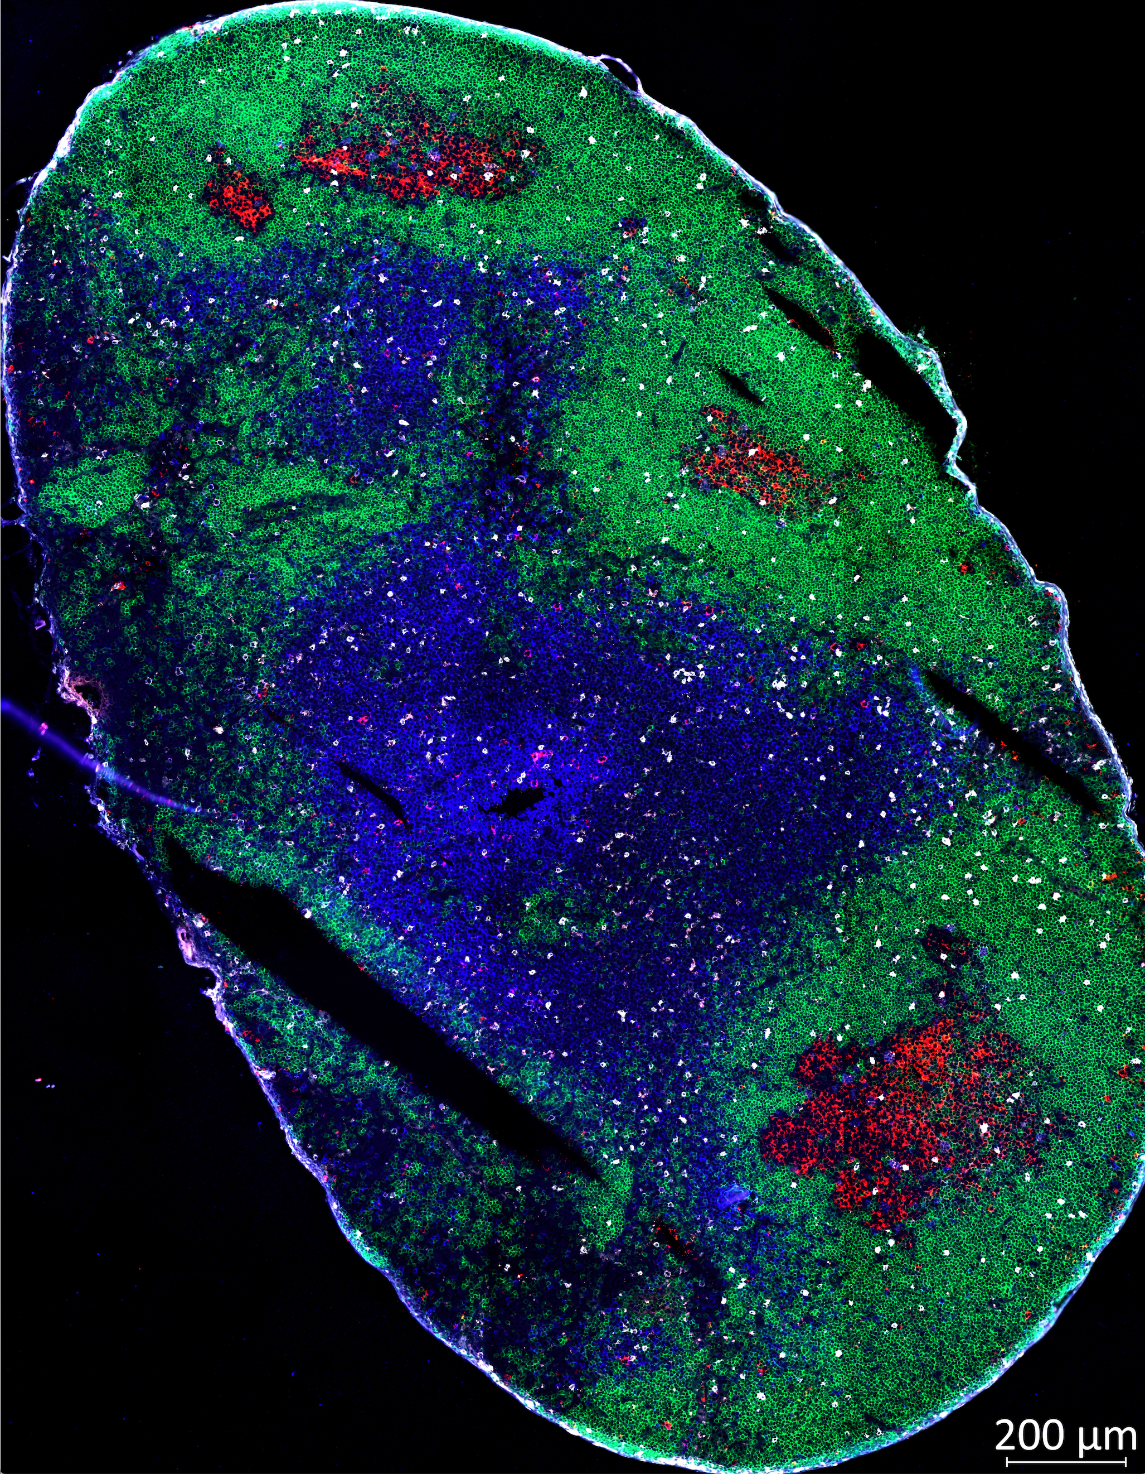
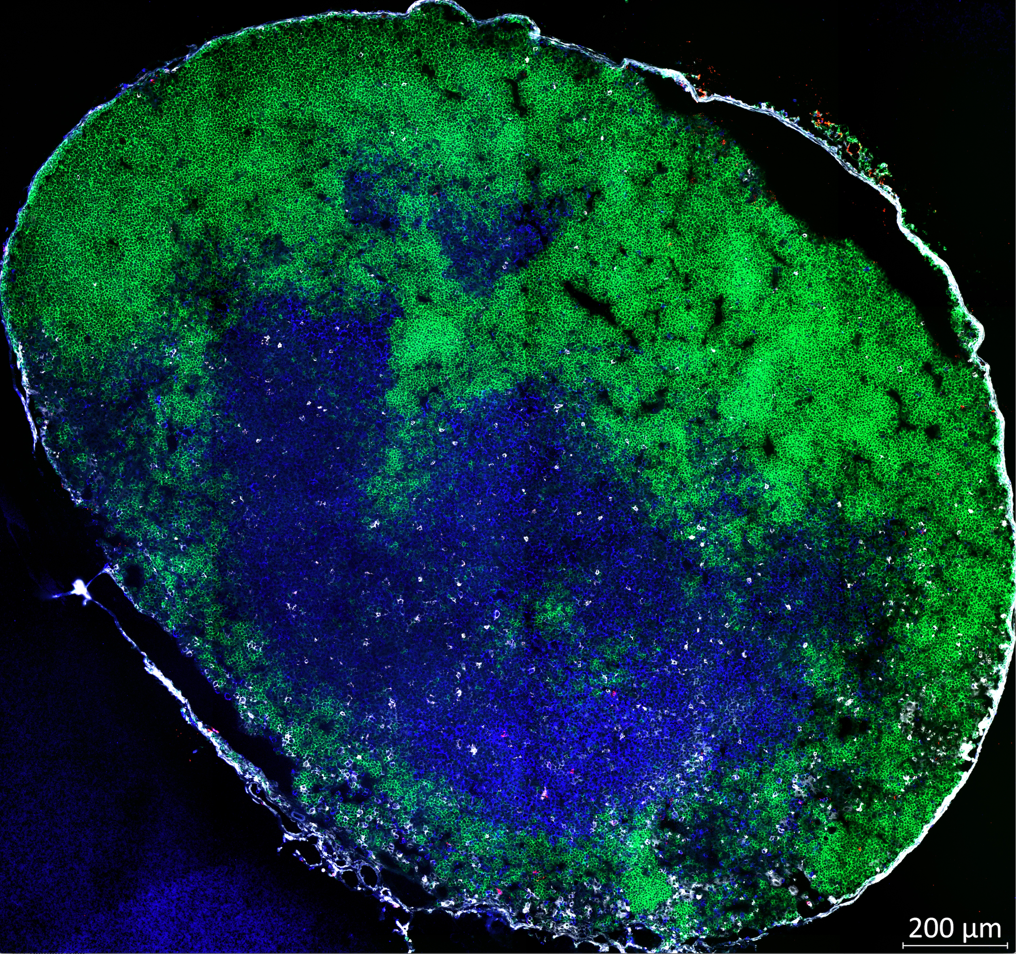
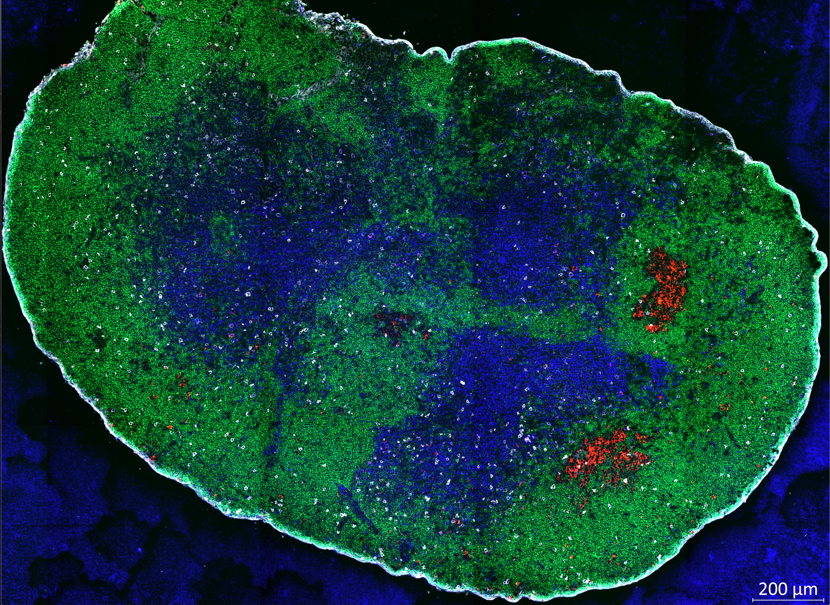
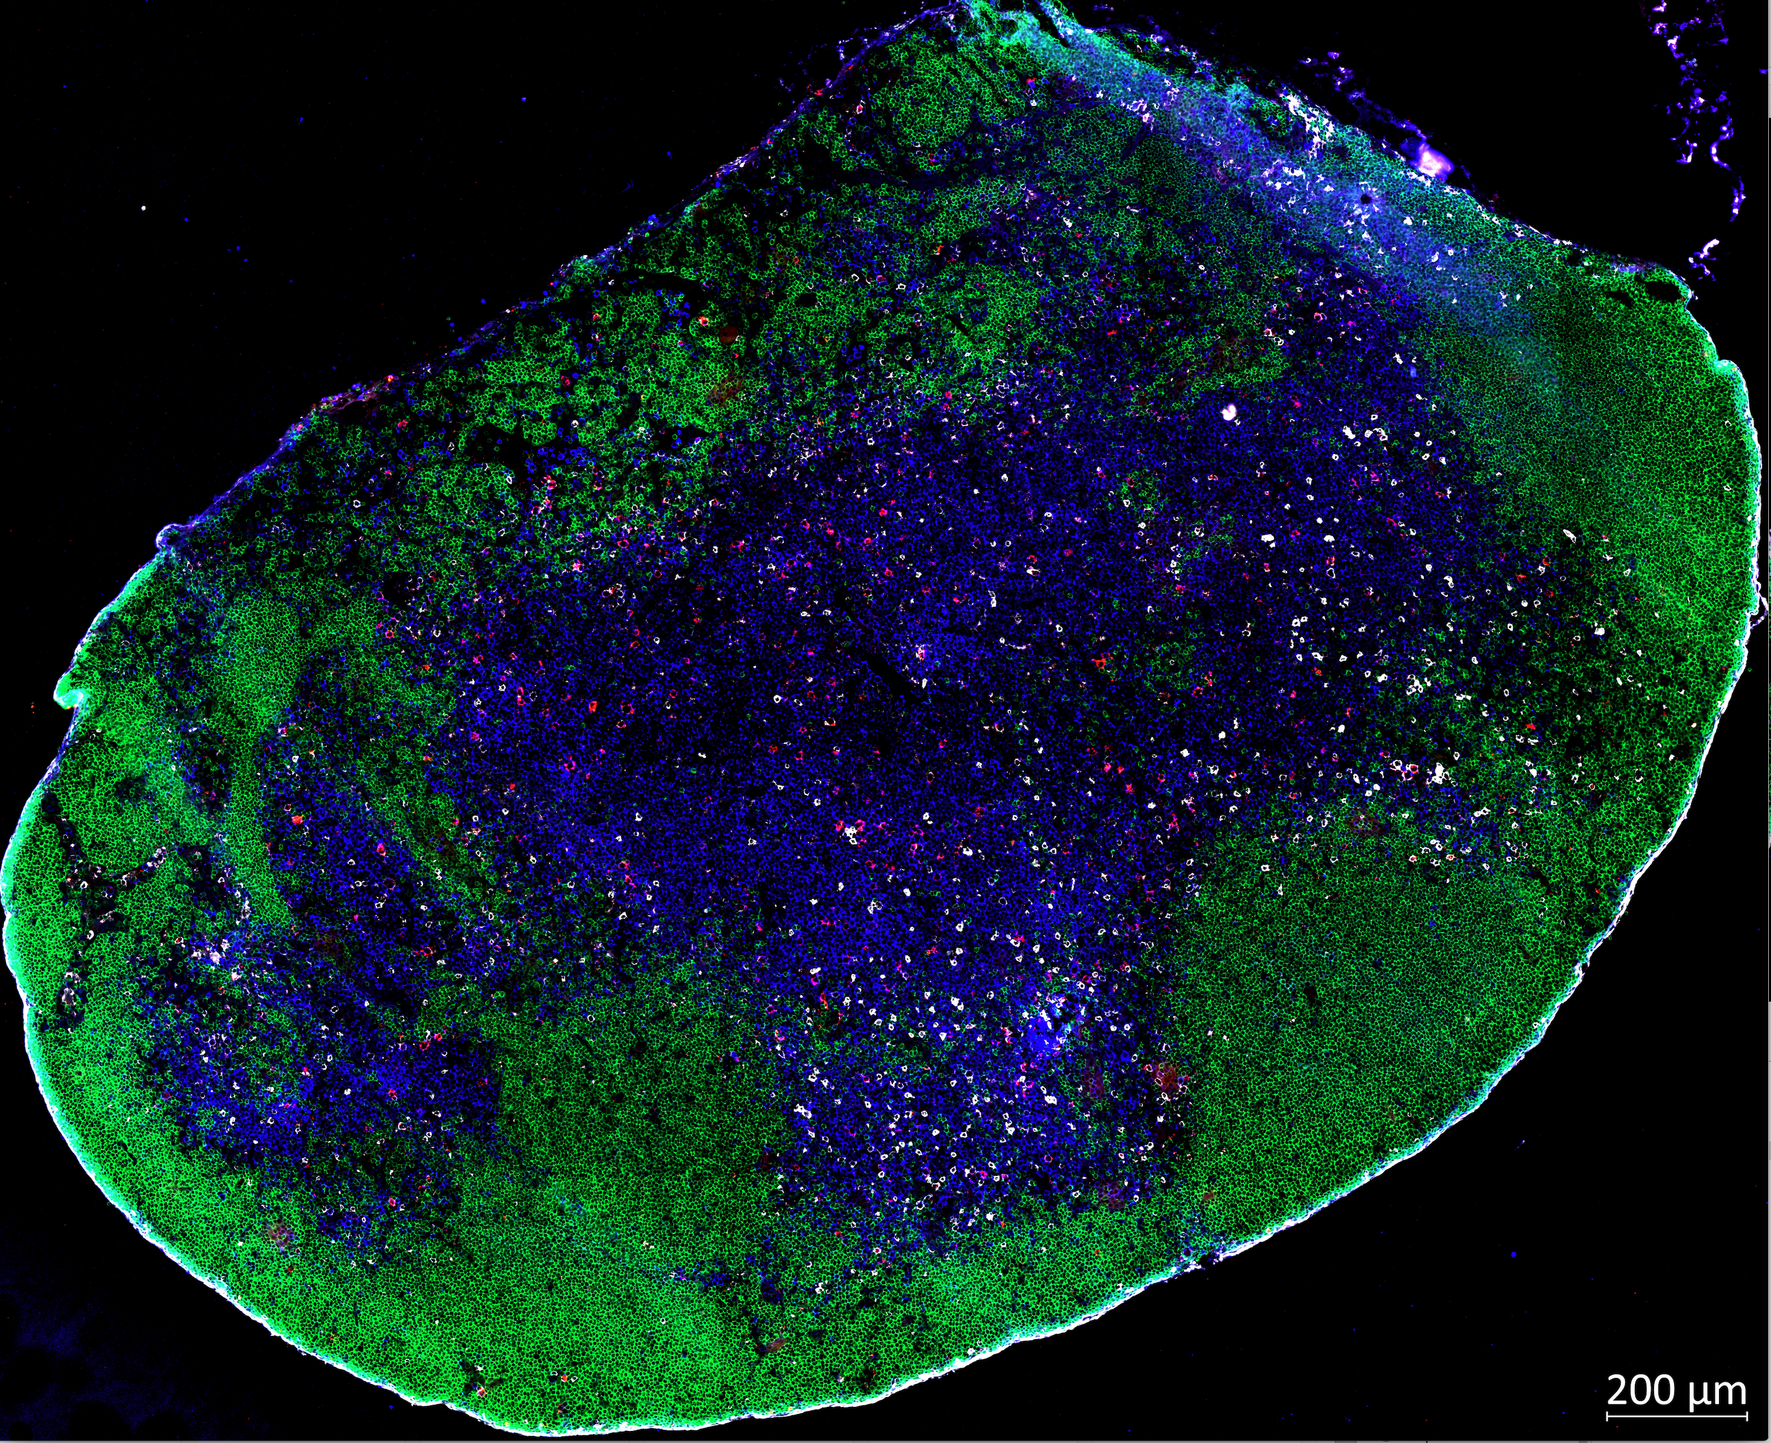
Effect of Bcl6 / Prdm1 Combined Deficiency on Tfh Differentiation
SMARTA Cd4-Cre⁺ CD45.1⁺
cells
KLH-gp61
Analysis
1. WT
2. Bcl6^{f/f}
3. Prdm1^{f/f}
4. Bcl6^{f/f}Prdm1^{f/f}
d-1
d0
d8
recipient
Bcl6^{f/f} Cd4-Cre⁺
WT
Bcl6^{f/f}
Prdm1^{f/f}
Bcl6^{f/f} Prdm1^{f/f}
Unimmunized
GC B cells
WT
**
Bcl6^{f/f}
Prdm1^{f/f}
FAS
Bcl6^{f/f}Prdm1^{f/f}
Unimmunized control
PNA
WT
Bcl6^{f/f}
Prdm1^{f/f}
Bcl6^{f/f} Prdm1^{f/f}
IgD TCR𝛽 GL7 CD45.1 (white)
Generation of germinal center B cells was severely diminished in mice receiving Bcl6^{f/f} Prdm1^{f/f} SMARTA CD4 T cells.
Bcl6^{f/f} Prdm1^{f/f} SMARTA CD4 T cells did not enter B cell follicles.

Slide 6
Effect of Bcl6 / Prdm1 Combined Deficiency on Tfh Differentiation: A Second Model System
SMARTA Cd4-Cre⁺ CD45.1⁺
LCMV
Armstrong
cells
Analysis
1. WT
2. Bcl6^{f/f}
3. Prdm1^{f/f}
4. Bcl6^{f/f}Prdm1^{f/f}
d-1
d0
d7
d8
recipient
WT B6 or
Bcl6^{f/f} Cd4-Cre⁺
CXCR5^{hi} SLAM^{lo} Tfh
WT
Bcl6^{f/f}
Prdm1^{f/f}
Bcl6^{f/f} Prdm1^{f/f}
**
WT
**
**
Bcl6^{f/f}
SLAM
Prdm1^{f/f}
Bcl6^{f/f}Prdm1^{f/f}
CXCR5
GC Tfh Core Signature Genes
**
ns
**
**
FAS
PNA
Bcl6^{f/f} Prdm1^{f/f} SMARTA cells failed to properly differentiate into Tfh cells.
Bcl6^{f/f} Prdm1^{f/f} SMARTA CD4 T cells had severely impaired differentiation into GC Tfh cells.

Slide 7
The Mechanism of Tfh Differentiation. What is the Role of Bcl6?
2. What transcription factors are downstream of Bcl6?
E protein family members are important in Tfh differentiation and are known to positively regulate CXCR5 gene expression.
Id2 is an inhibitor of E proteins and is an important regulator of Tfh differentiation.
Crotty, 2014 Immunity, 41:529–542
Shaw, et al., 2016 Nat Imm, 17: 834–843
Liu, et al., 2014 Nature, 507: 513–518
Id2
Id2
E
E
E
CXCR5
Bcl6
Prdm1/Blimp1
Blimp1
Hypothesis:
Bcl6 induces Tfh differentiation by inhibiting two transcription factors: Blimp1 and Id2

Slide 8
Effect of Bcl6, Prdm1 and Id2 Triple Knockout on Tfh Differentiation
SMARTA Cd4-Cre⁺ CD45.1⁺
LCMV
Armstrong
cells
Analysis
1. WT
2. Bcl6^{f/f}Prdm1^{f/f}
3. Bcl6^{f/f}Prdm1^{f/f}Id2^{f/f}
d-1
d0
d7
recipient
WT B6
WT
Bcl6^{f/f}Prdm1^{f/f}
Bcl6^{f/f}Prdm1^{f/f}Id2^{f/f}
Bcl6
CXCR5^{hi} SLAM^{lo} Tfh
*
***
WT
SLAM
Bcl6^{f/f}Prdm1^{f/f}
Blimp1
Id2
Bcl6^{f/f}Prdm1^{f/f}Id2^{f/f}
E proteins
CXCR5^{hi} PSGL1^{lo} GC Tfh
**
Activated
CD4
Tfh
PSGL-1
CXCR5^{hi} PD1^{hi} GC Tfh
**
PD-1
CXCR5
Bcl6^{f/f} Prdm1^{f/f} Id2^{f/f} SMARTA cells failed to differentiate into GC Tfh cells.

Slide 9
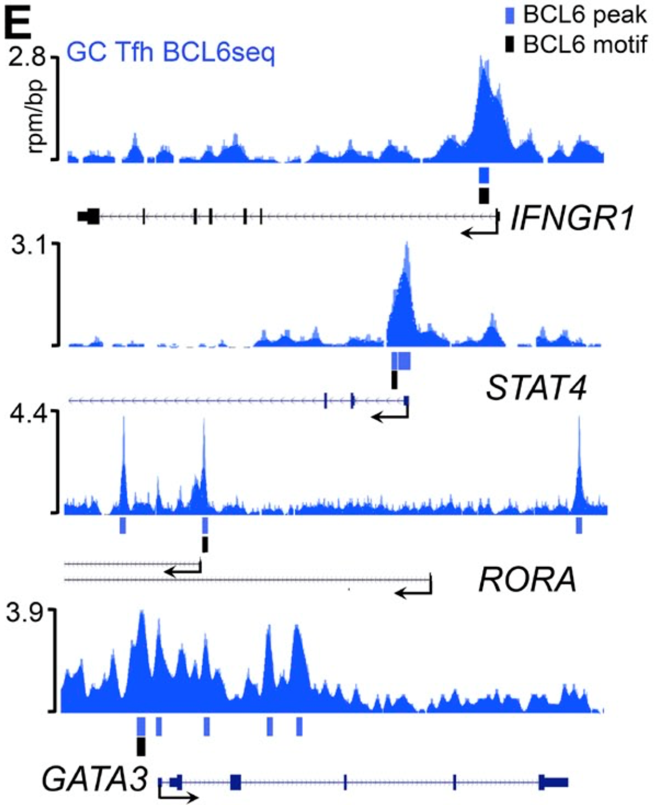
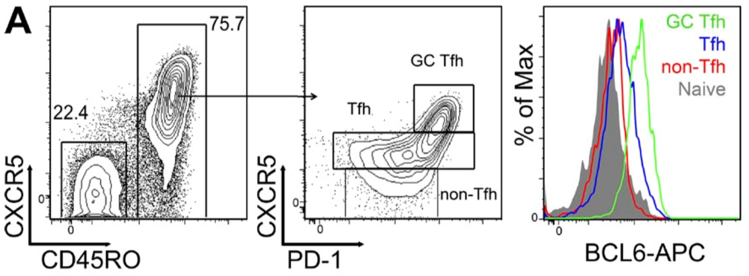
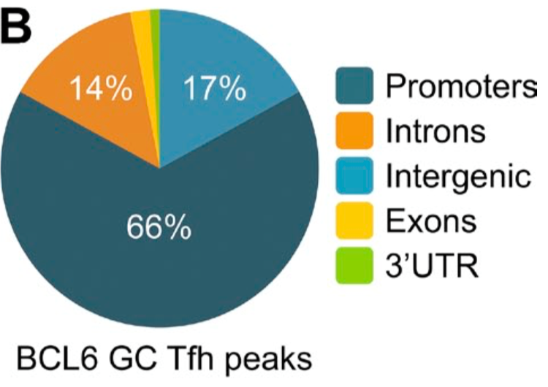
Bcl6 Regulates Tfh Biology via Complex Gene Regulation
Human GC Tfh cells
BCL6 ChIP-Seq
Hatzi, et al., 2015 J Exp Med, 212: 539–553
Bcl6 most potently represses promoters where it binds to its cognate DNA motif.

Slide 10
Experimental Design for RNA-Seq
SMARTA Cd4-Cre⁺ CD45.1⁺
LCMV
Armstrong
cells
Sort
RNA-Seq
1. WT
2. Bcl6^{f/f}
3. Prdm1^{f/f}
4. Bcl6^{f/f}Prdm1^{f/f}
d-1
d0
d7
recipient
WT B6
WT
Bcl6^{f/f}
Prdm1^{f/f}
Bcl6^{f/f} Prdm1^{f/f}
Naïve SMARTA
SLAM
CD44
CXCR5
CD62L
WT
Th1
WT
Tfh
Bcl6^{f/f}
Th1
Prdm1^{f/f}
Tfh
Bcl6^{f/f}Prdm1^{f/f}
Th1
Bcl6^{f/f}Prdm1^{f/f}
Tfh
Naïve

Slide 11
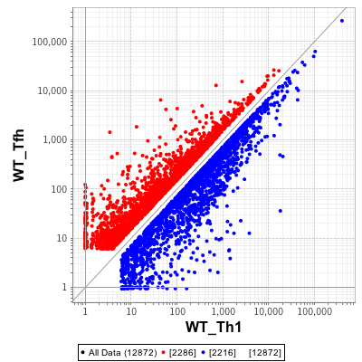
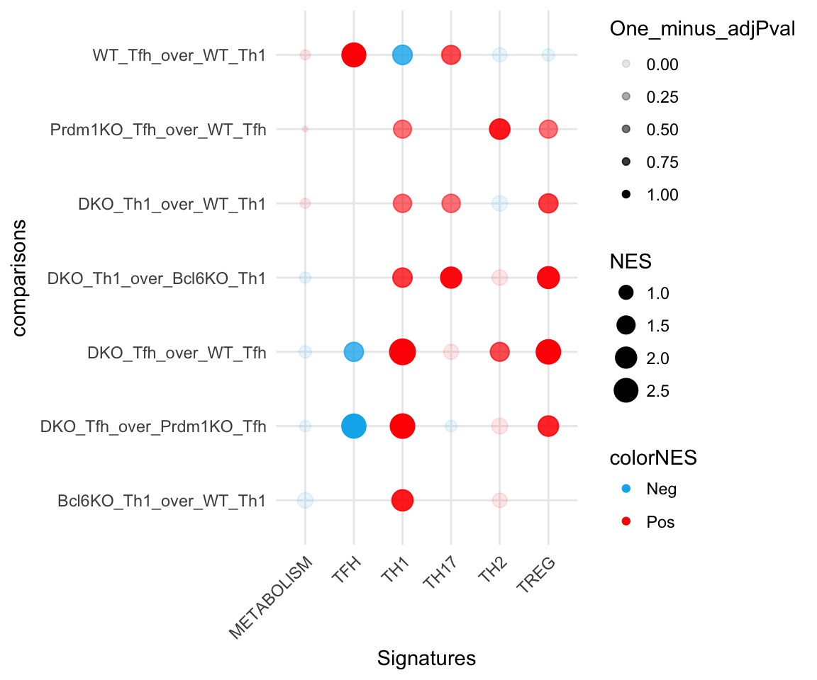
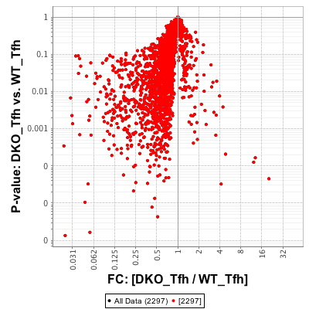
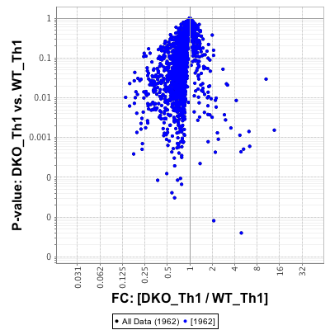
Gene Expression Changes by Bcl6
Signatures
Tfh
Th1
Th17
Th2
Treg
Icos
2,297
1 – pValue
Pdcd1
WT Tfh vs.
WT Th1
Tcf7
Cd200
Il7r
Id2
Id3
Tbx21
Cxcr5
Slamf1
WT Tfh (expression)
Gata3
Prdm1^{f/f} Tfh vs.
WT Tfh
Rorc
1,962
Bcl6^{f/f} Prdm1^{f/f} Tfh vs.
WT Tfh
WT Th1 (expression)
WT Tfh > WT Th1
(Tfh-associated genes; 2,297)
WT Th1 > WT Tfh
(Th1-associated genes; 1,962)
Bcl6^{f/f} Prdm1^{f/f} Tfh vs.
Prdm1^{f/f} Tfh
1,661
(84%)
301
(16%)
NES
2,028
(88%)
Id3
269
(12%)
Tbx21
Gata3
Bcl6^{f/f} Th1 vs.
WT Th1
Slamf1
p-value
p-value
Id2
Pdcd1
Il7r
Rorc
Icos
Tcf7
Bcl6^{f/f} Prdm1^{f/f} Th1 vs.
WT Th1
Cxcr5
Cd200
WT Tfh
Bcl6^{f/f} Prdm1^{f/f} Tfh
WT Th1
Bcl6^{f/f} Prdm1^{f/f} Th1
Bcl6^{f/f} Prdm1^{f/f} Th1 vs.
Bcl6^{f/f} Th1
Vast majority of Tfh-associated genes require Bcl6 expression.
Bcl6^{f/f} Prdm1^{f/f} SMARTA cells showed alternative Th cell signatures including Th1, Th17 and Treg.

Slide 12
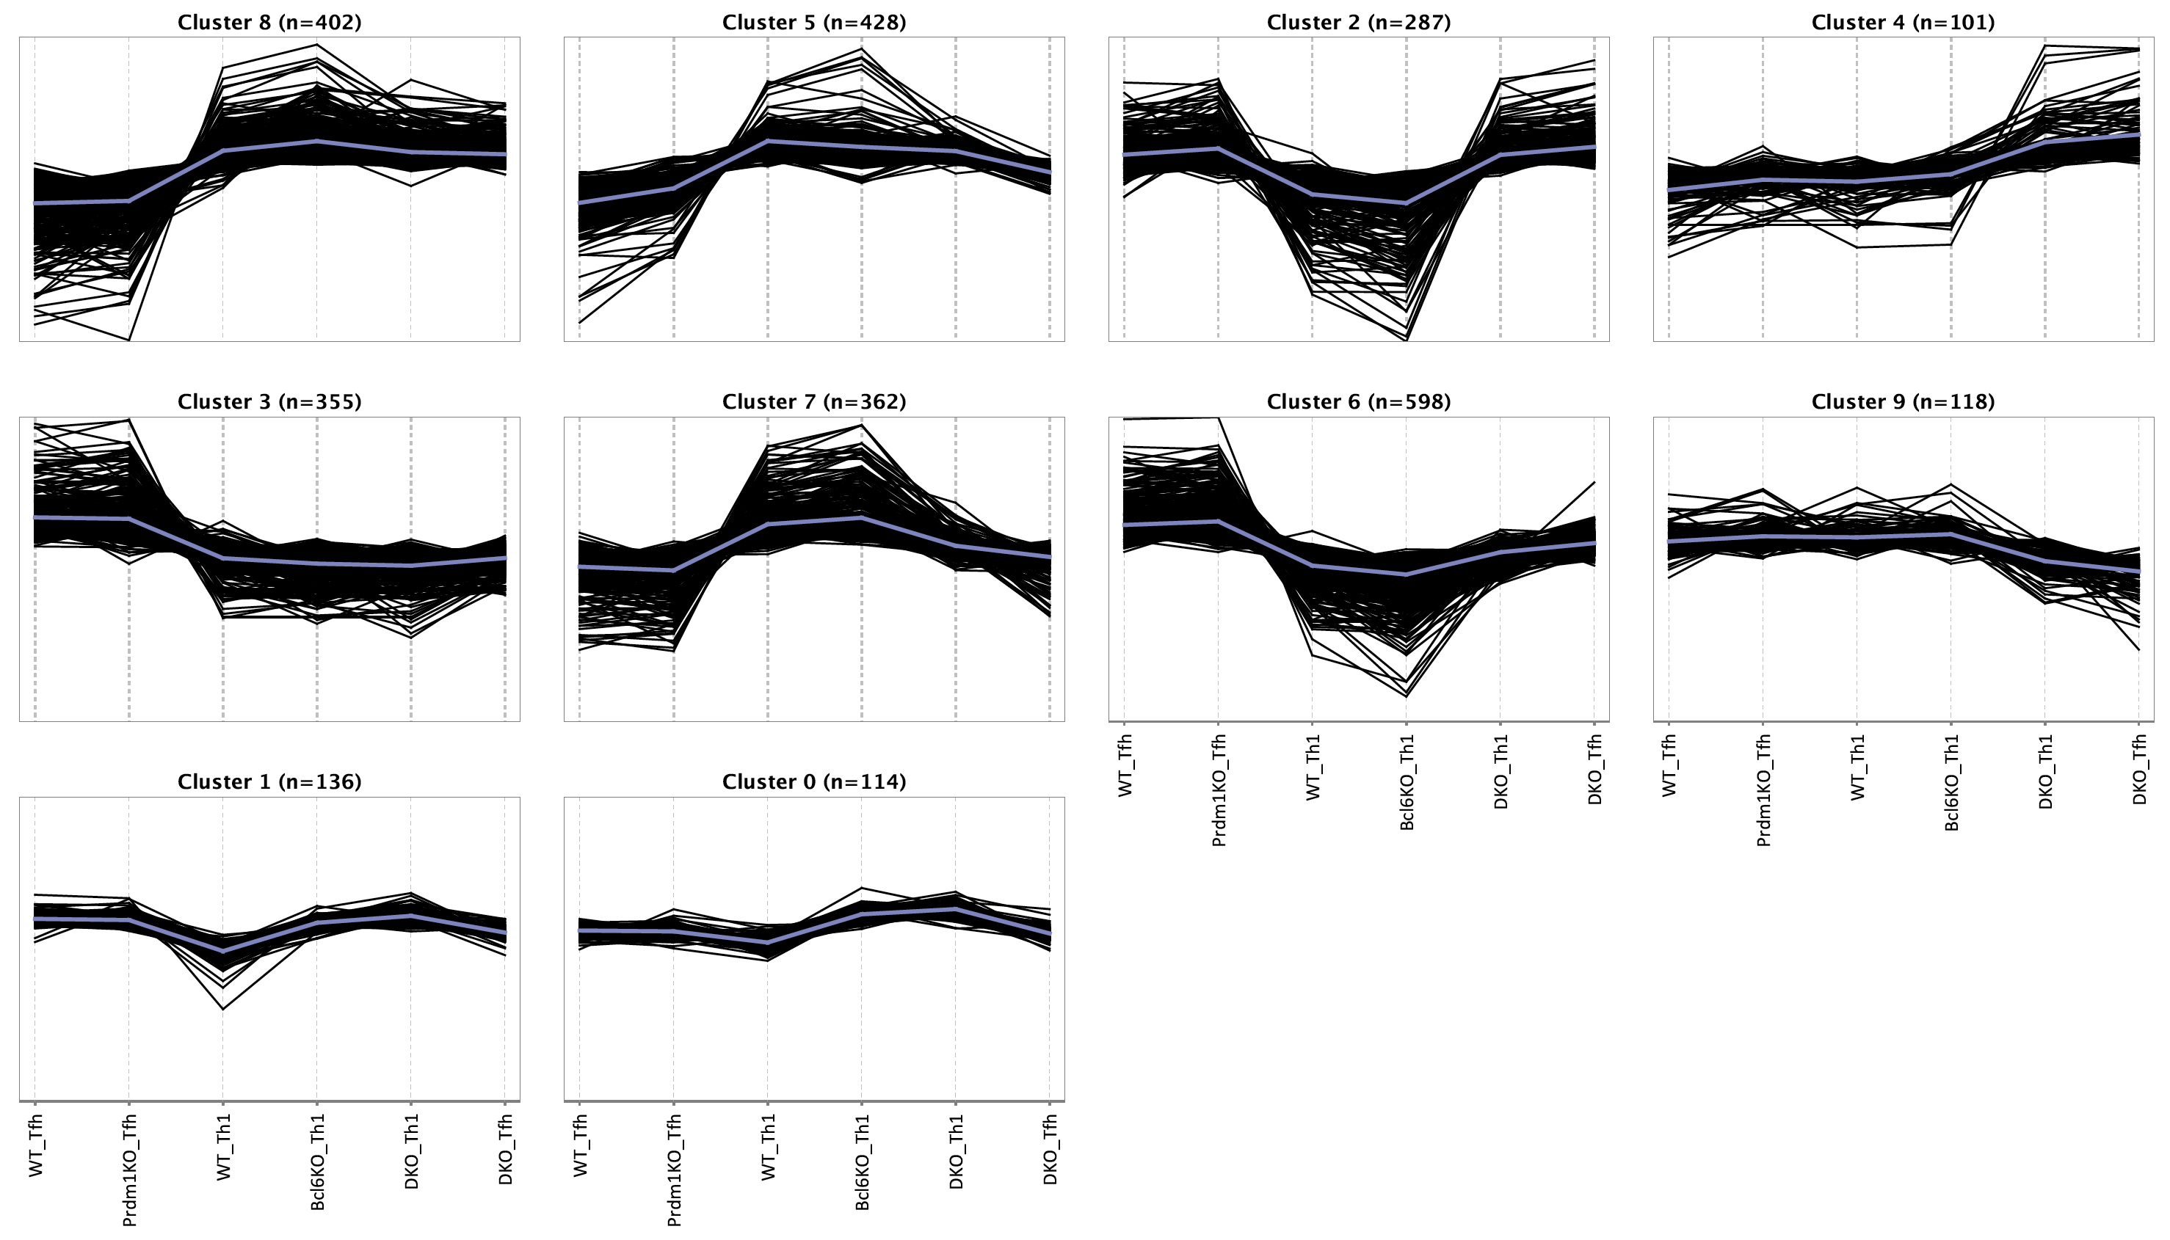
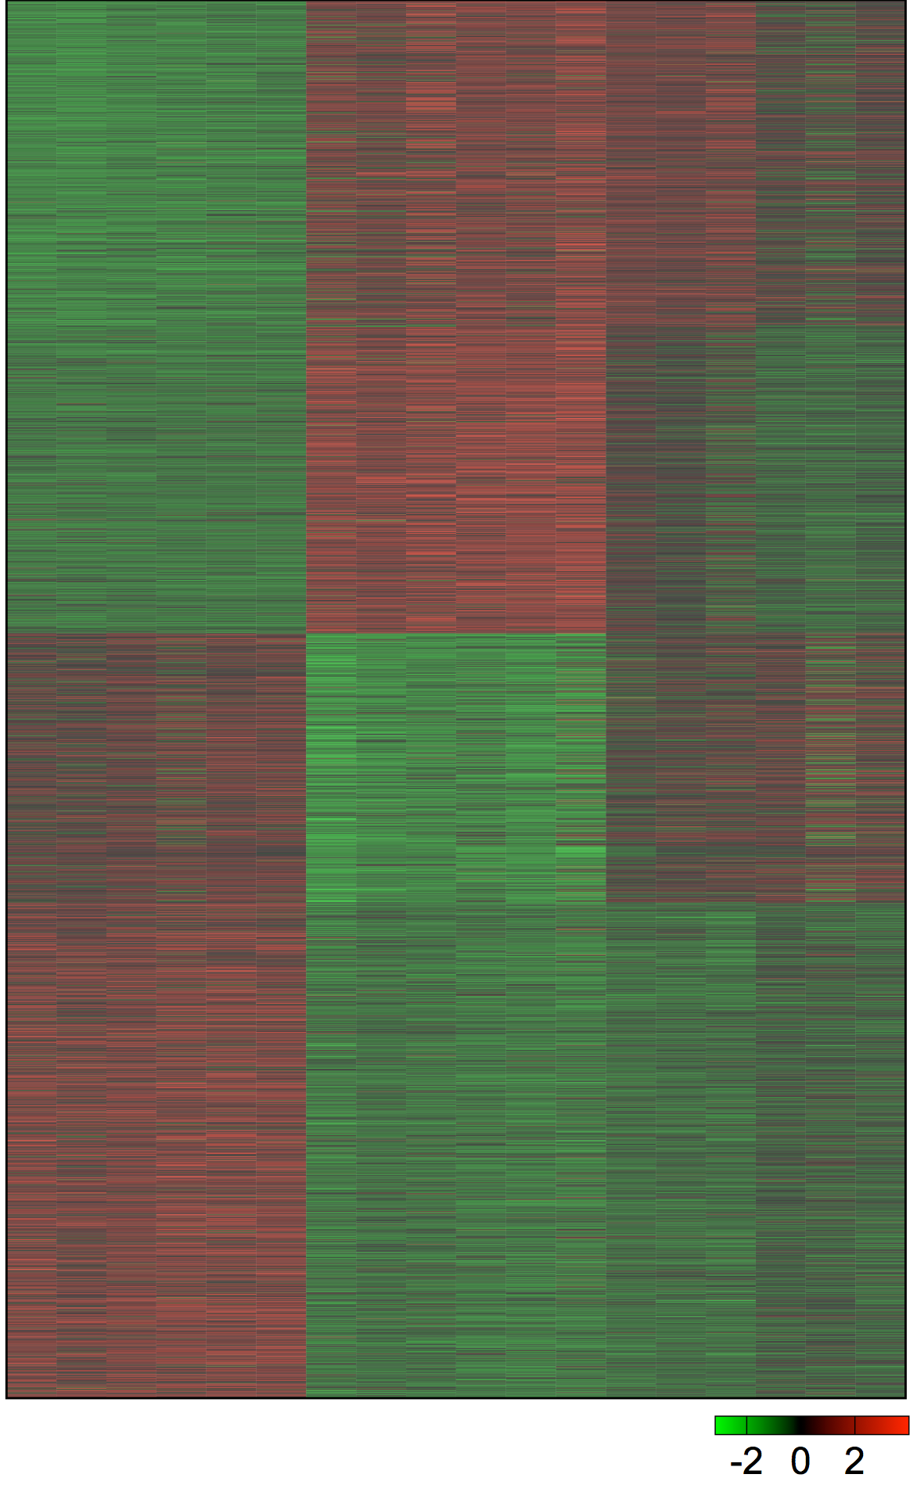
Clustering Analyses of Gene Expression Changes in Bcl6 / Prdm1 Deficient CD4 T Cells
K-means Clustering (K=10)
WT
Tfh
Prdm1^{f/f}
Tfh
WT
Th1
Bcl6^{f/f}
Th1
Bcl6^{f/f}
Prdm1^{f/f}
Th1
Bcl6^{f/f}
Prdm1^{f/f}
Tfh
Runx2, Runx3, Chd7
Tbx21, Gata3, Maf
Smad7, Brca1, Brca2
Il2ra, Il2rb
Il12rb1, Ifngr1
Itga4, Itgb7
Selplg
Group I (872)
Id2, Rorc, Zeb2
Slamf1, Ly6c2
Fasl, Itgb2
Ifng
Group II (815)
Id3, Foxo1, Fosb
Tcf12, Nfkb2, Nfe2l2
Tnfsf8 (CD30L)
Ccr7, Slamf6
Tnf, Lta
Group III (718)
Tcf7, Lef1, Rel, Foxp1
Fos, Jund, Stat5a
Padi4, Bcor, Batf
Pou2af1, Egr1, Ikzf2, Ikzf4
Cebpa, Irf6, Irf7, Myc
Icos, Cd200
Cxcr5, Cxcr4
Pdcd1, Sh2d1a
Tnfrsf4 (OX40) Btla, Il6ra, Il6st,
Cd69, Cd160
Il21
Group IV (1,318)
WT
Tfh
Prdm1^{f/f}
Tfh
WT
Th1
Bcl6^{f/f}
Th1
Bcl6^{f/f}
Prdm1^{f/f}
Th1
Bcl6^{f/f}
Prdm1^{f/f}
Tfh
K-means clustering readily separated four gene expression patterns.

Slide 13
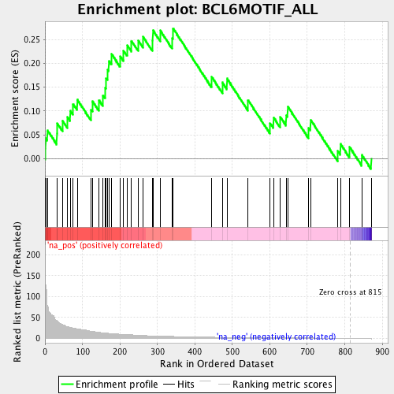
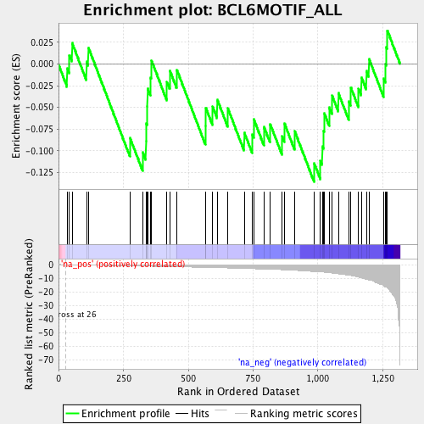
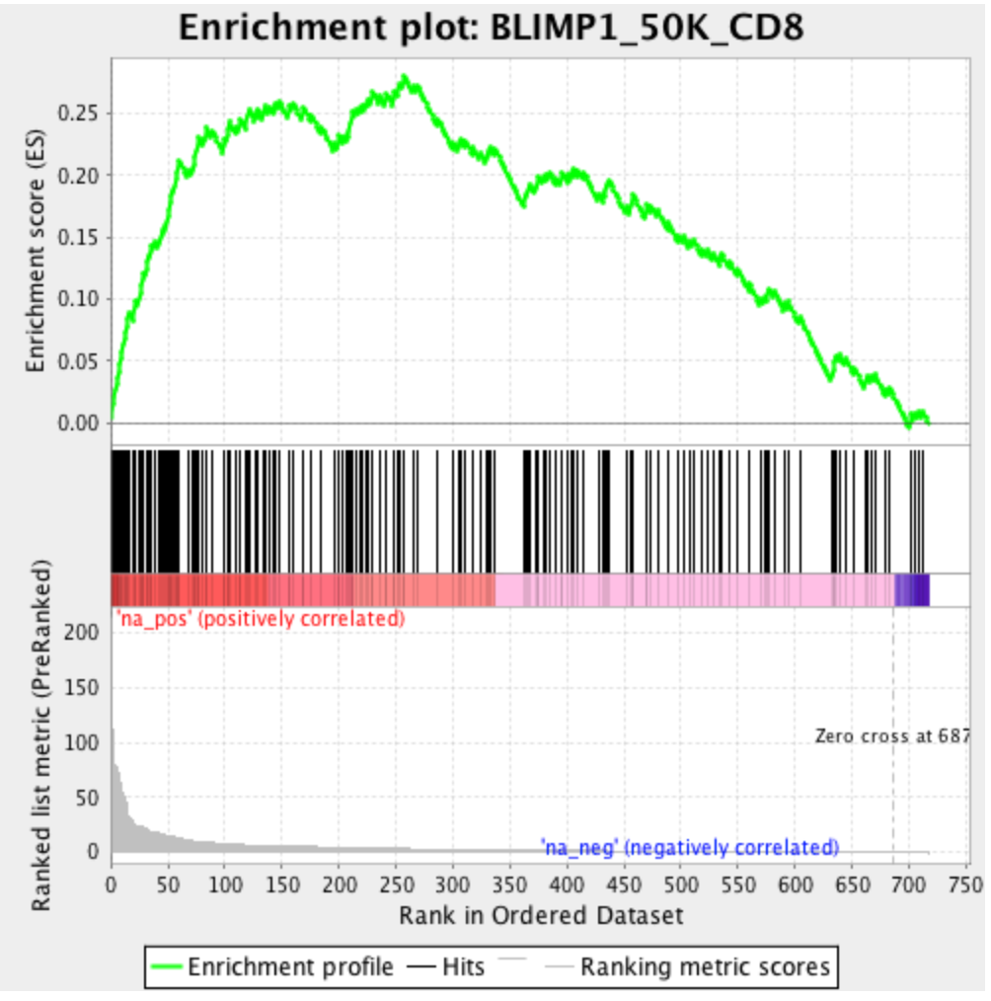
Simple Circuitry Models of Gene Expression Changes
in Bcl6 / Prdm1 Deficient CD4 T Cells
Bcl6
Group I
Blimp1
Group III
Group I
Bcl6-i genes
Blimp1-i genes
Group II
TFs
TFs
Th1⁺ genes
TFs
TFs
Tfh⁺ genes
Group IV
Group II
Group III
Tfh⁺ genes
Th1⁺ genes
Bcl6-ii genes
Blimp1-ii genes
Group IV
Tfh function
BCL6 target genes*
Blimp1 target genes**
Group I genes
Group IV genes
Group III genes
NES: 2.159
p< 0.002
FDR: 0.0098
NES: -1.088
p< 0.332
FDR: 0.4256
NES: 3.930
p< 0.0001
FDR< 0.0001
Enrichment score (ES)
Enrichment score (ES)
Enrichment score (ES)
Bcl6^{f/f}Prdm1^{f/f} Tfh
Prdm1^{f/f} Tfh
Bcl6^{f/f}Prdm1^{f/f} Tfh
Prdm1^{f/f} Tfh
Bcl6^{f/f}Prdm1^{f/f} Th1
Bcl6^{f/f} Th1
Selplg, Runx2
Il2rb, Maf
Gsk3a, Usp25
Hdac4
Ncor2
Batf Ddx60
Ccr7, Tnfsf8, Id3
Slamf6, Lta, Ifnar2
Nlrp1b
Gclc
*Gene list from human GC Tfh cells
**Gene list from activated CD8 cells
Group I genes are positively correlated with Bcl6 target genes,
while Group III genes are positively correlated with Blimp1 target genes.

Slide 14

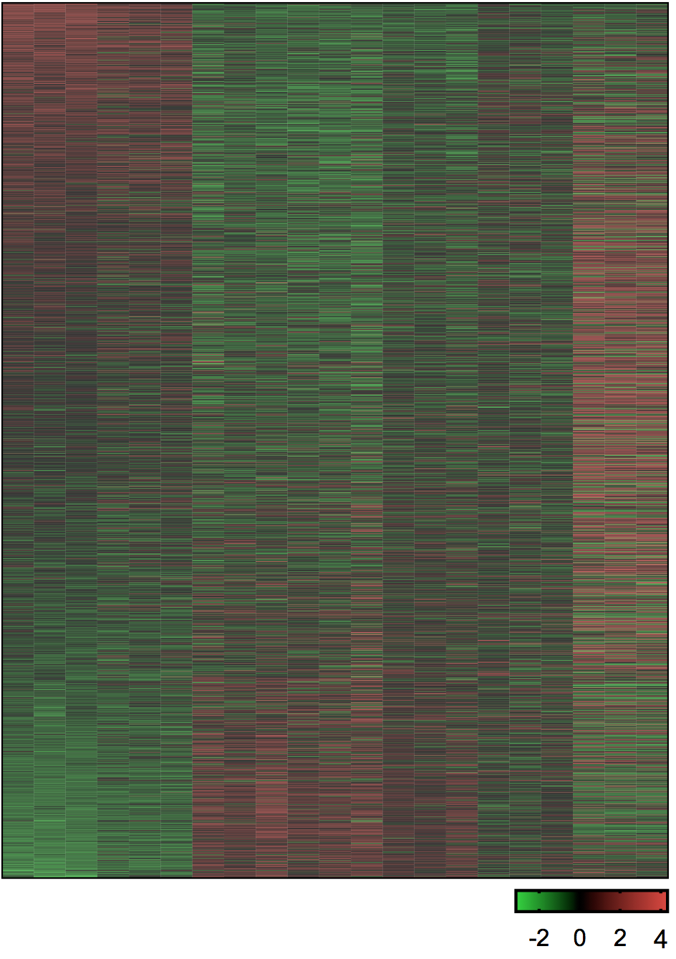
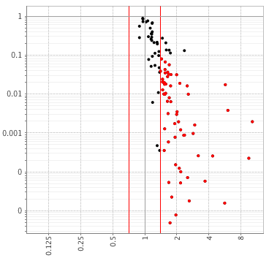
Strategies for Identification of Potentially Important Bcl6 Target TFs in Tfh Differentiation
Bcl6
Group I
Bcl6-i genes
TFs
TFs
Th1⁺ genes
Group IV
Tfh⁺ genes
Bcl6-ii genes
Tfh function
Sources:
1. Human GC Tfh BCL6 ChIP-Seq: Available
2. Mouse Bcl6 ChIP-Seq: in progress
ATAC-Seq
RNA-Seq
ChIP-Seq
Bcl6-target genes
Group I TFs (108 genes)
TF-targeted
genes
TF expression
Bcl6-i TFs
Sources:
LCMV infection
Protein (KLH-gp₆₁) immunization
RNA-Seq
p-value
Customized PageRank
Strong candidate TFs that regulate Bcl6-ii Tfh genes
Prdm1^{f/f} Tfh
Bcl6^{f/f} Prdm1^{f/f} Tfh

Slide 15
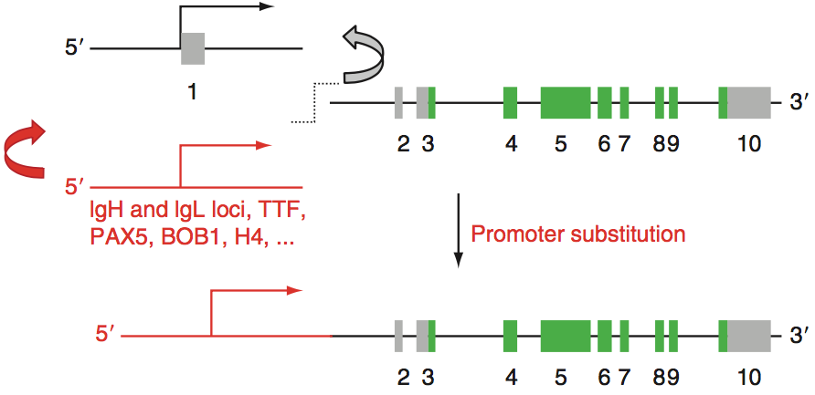
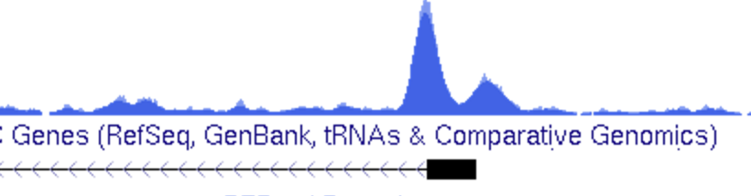
Regulation of Bcl6 Expression by Bcl6
Rearrangements of BCL6 were detectable in ~40% of diffuse large B cell lymphoma (DLBCL) and 5–10% of follicular lymphoma.
Substitution of its 5’ regulatory region with heterologous promoters upregulated BCL6 expression.
A subset of DLBCL (~14%) carrying in BCL6 5’ regulatory region-specific mutations which lead to its deregulated expression by disrupting an autoregulatory circuit.
Basso and Dalla Favera, 2010 Advances in Immunology, 193–210
Pasqualucci et al., 2003 Blood,101: 2914–2923
Wang et al., 2002 PNAS, 99: 15018–15023
Human GC Tfh cells
BCL6 peaks
+ or - in Tfh?
BCL6 motif
STAT motif
Bcl6
TCTAGGAA
Bcl6
BCL6
Bcl6 motif
Hatzi, et al., 2015 J Exp Med, 212: 539–553

Slide 16
Effect of ΔBPS1 on Bcl6 Promoter Activity
Retroviral Reporter Plasmids (Self-inactive LTR)
RV transduction of
SMARTA CD45.1⁺
LCMV
Armstrong
-709
+272
cells
Analysis
Bcl6Pro WT-RV
Bcl6 Pro
Thy1.1
pGK
eGFP
1. WT RV+
2. ΔBPS1 RV+
+18, BPS1: TCTAGGAA
d-3
d0
d6
recipient
WT B6
Bcl6Pro ΔBPS1-RV
Bcl6 Pro
Thy1.1
pGK
eGFP
+18, ΔBPS1 (8 bp)
*BPS1: Bcl6 Promoter Site 1
WT-RV
ΔBPS1-RV
Bcl6 Promoter-RV
Thy1.1⁺ (% of SM cells)
Thy1.1 expression (gMFI)
GC Tfh
WT-RV
ΔBPS1-RV
****
***
Thy1.1⁺ (% of SM cells)
Thy1.1 expression (gMFI)
Non-Tfh
WT-RV
GC Tfh
ΔBPS1-RV
*
ns
Bcl6
CD4
Non-Tfh
CXCR5
Thy1.1
Bcl6 DNA-binding motif deletion in the Bcl6 promoter increased promoter activity in Tfh cells.

Slide 17
Effect of ΔBPS1 on Tfh Differentiation
BPS1 deletion by CRISPR/Cas9
LCMV
Armstrong
SMARTA CD45.1⁺
cells
Analysis
WT mouse
Bcl6 Pro
1. WT
2. ΔBPS1
+18, BPS1: TCTAGGAA
ΔBPS1 mouse
Bcl6 Pro
d-1
d0
d7
d8
+18, ΔBPS1 (8 bp)
Recipient
WT B6 or
Bcl6^{f/f} Cd4-Cre⁺
WT
ΔBPS1
CXCR5^{hi} SLAM^{lo} Tfh
CXCR5^{hi} SLAM^{lo} Tfh
*
WT
ΔBPS1
No transfer ctrl
SLAM
****
FAS
CXCR5^{hi} PSGL1^{lo} GC Tfh
CXCR5^{hi} PSGL1^{lo} GC Tfh
**
PSGL-1
PNA
*
GC B Cells
WT
p=0.0856
ΔBPS1
CXCR5^{hi} Bcl6^{hi} GC Tfh
CXCR5^{hi} Bcl6^{hi/lo} Tfh
No transfer ctrl
**
****
Bcl6
CXCR5
ΔBPS1 SMARTA CD4 T cells showed increased Bcl6 expression and Tfh differentiation in acute LCMV infection.

Slide 18
Regulation of Tfh Differentiation by Bcl6
(NAR)
(Inhibition
of
Inhibitor)
Differentiation
Location
Tfh products
Th1 Program
Alternative fates
Bcl6
Tfh Program
Blimp1
*NAR: Negative autoregulation
Preliminary PageRank Analysis
Bcl6
Group I
Bcl6-i genes
TFs
?
TFs
?
Klf12
Runx2
Runx3
Rxra
Irf1
Arid3b
E2f3
Gata3
Tbx21
Runx2
Runx3
Rxra
Irf1
Th1⁺ genes
Group IV
Tfh⁺ genes
Bcl6-ii genes
CXCR5, PD-1, CXCL13, SAP…
Tfh function

Slide 19
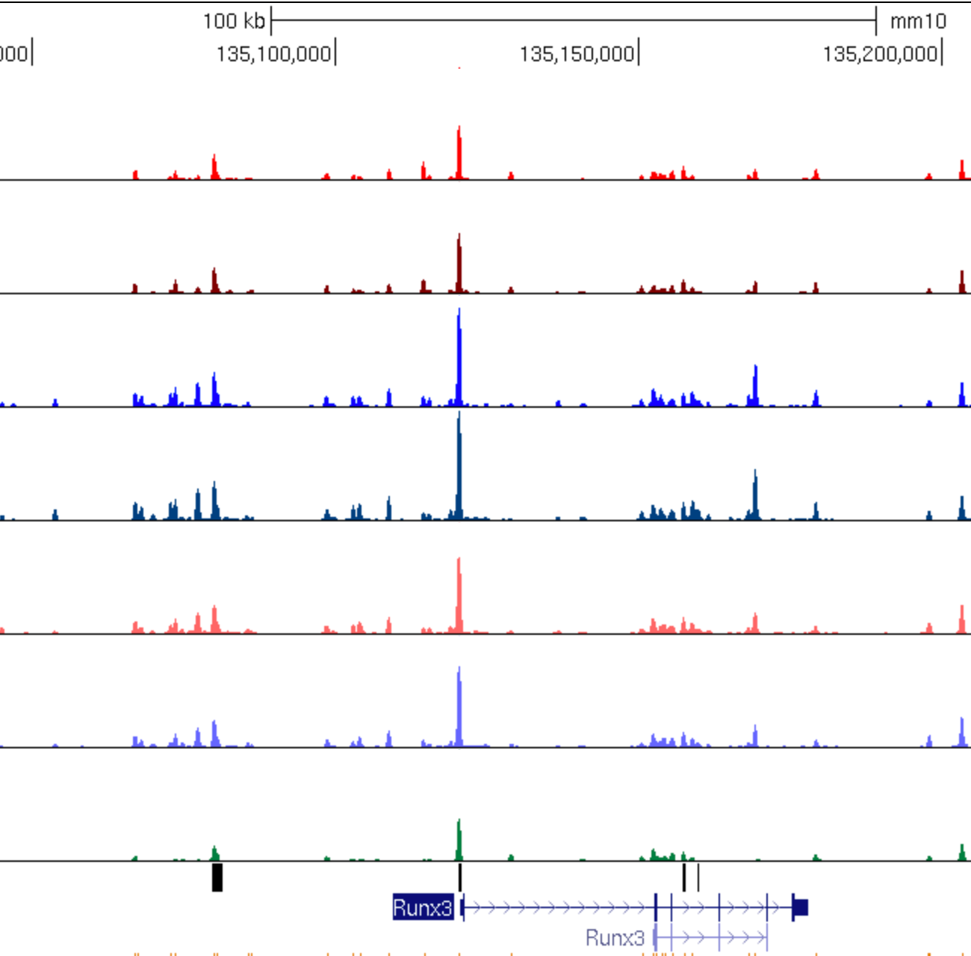
Future Directions
Ongoing Plans - Customized Rankscore analyses - Testing candidate TFs by knockdown and overexpression : Runx3 - Murine Bcl6 ChIP-Seq by using tag-Bcl6 expressing RV+
Future Directions (1) Bcl6 target TFs that regulate genes for Tfh differentiation and function - Will generate top 10 Bcl6-i TFs identified by the integrated RNAseq-ATAC-Seq-PageRank analysis. : Sh2d1a, Icos and Cxcr5 (Group IV genes) targeting TFs will be considered as candidates. - DNA binding motif deleted mice will be generated via CRISPR-Cas9. (2) Bcl6 target TFs that regulate genes for non-Tfh - CRISPR/Cas9 deletion of Bcl6 sites mapped at Tbx21, Gata3, Rorc, Rora and Runx3 (3) Bcl6 negative autoregulation (NAR) - Will try multiple models (NP-KLH, eOD-GT) - Tfh memory: (i) Transfer of dBPS1 Sm into congenic hosts, LCMV infection or KLH-gp immunization : Phenotyping at d30, d60, d90 and d180. (ii) Non tg CD4 T cell memory development: direct infection or immunization of dBPS1 mice : tracking development of memory T cell with class II tetramer (6 and 12 months age) - Immunophenotyping: T cells and B cells development
10 kb
WT Tfh
Prdm1^{f/f} Tfh
WT Th1
Bcl6^{f/f} Th1
Bcl6^{f/f} Prdm1^{f/f} Th1
Bcl6^{f/f} Prdm1^{f/f} Th1
Naive
Bcl6 ChIP-Seq Peaks
Runx3

Slide 20

Acknowledgement
Shane Crotty Lab
- All present and past lab members
LJI
DLAC
Flow Cytometry Core
Bioinformatics Core
Sequencing Core
Ananda Goldrath Lab, UCSD
- Bingfei Yu
Matthew Pipkin Lab, Scripps Florida

Slide 22
PageRank and Gene Expression
Ascl2
Tcf7
Bach2
Irf1
PageRank Score
Log₂FC(WT_Tfh/WT_Th1)
Runx2
Bcl6
Rxra
Klf12
Fos
Tbx21
Prdm1
Gata3
E2f3
Arid3b
Expression
Log₂FC(WT_Tfh/WT_Th1)

Slide 23
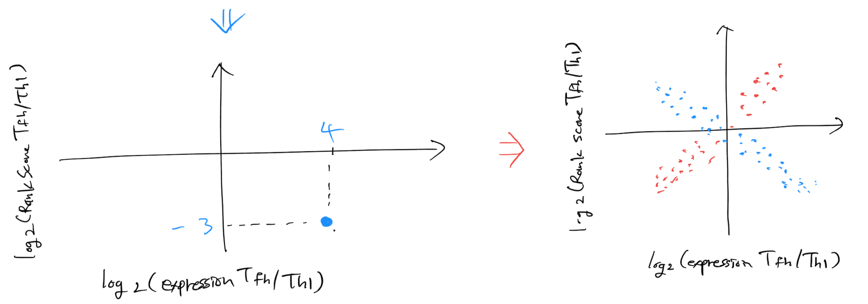
Examples to expect:
In comparison WT Tfh and WT Th1 regarding repressor X:
X is a repressor that important Tfh differentiation.
The expression level of repressor X is higher in WT Tfh than WT Th1: e.g. Log2(expression WT Tfh/WT Th1) = 4
Target-genes of X
Tfh
Th1
A B C D E F G
-1 -1 -3 -2 -1 -4 -5 → -17
0 +1 0 0 0 +1 0 → +2
Rankscore (arbitrary)
Log2(Rankscore Tfh/Th1)
→
→
0.001
0.01
→
-3.32
Finally,
II
I
Activators
Log2 (Rankscore Tfh/Th1)
Log2 (Rankscore Tfh/Th1)
Repressors
III
IV
I: Important activators for Tfh
II: Important repressors for Th1
III: Important activators for Th1
IV: Important repressors for Tfh
Log2 (Expression Tfh/Th1)
Log2 (Expression Tfh/Th1)

Slide 24
Comparisons between New algorithms
Rank Score – Expression (WT Tfh vs. WT Th1) – ALL TFs
Dual TFs as activators
Dual TFs as repressors
JunD
Fos
Ascl2
Expression: Tfh hi
Rank score: Tfh hi
STAT5A
STAT5B
Tcf7
Hes5
Cebpa
Pax5
Cebpd
Zscan10
Bcl6
Mybl1
Trp73
Rxra
Mybl2
Rorc
Foxp3
Rara
Klf12
Bcl6b
E2F7
Bhlhe40
E2F8
Tbx21
Expression: Th1 hi
Rank score: Th1 hi
Prdm1
f.c=2
Q: Are the code for activators and the one for repressors the same?

Slide 25
Genes of Interest
Bcl6^{f/f}
Prdm1^{f/f}
Th1
Bcl6^{f/f}
Prdm1^{f/f}
Tfh
WT
Tfh
Prdm1^{f/f}
Tfh
WT
Th1
Bcl6^{f/f}
Th1
Naive

Slide 26

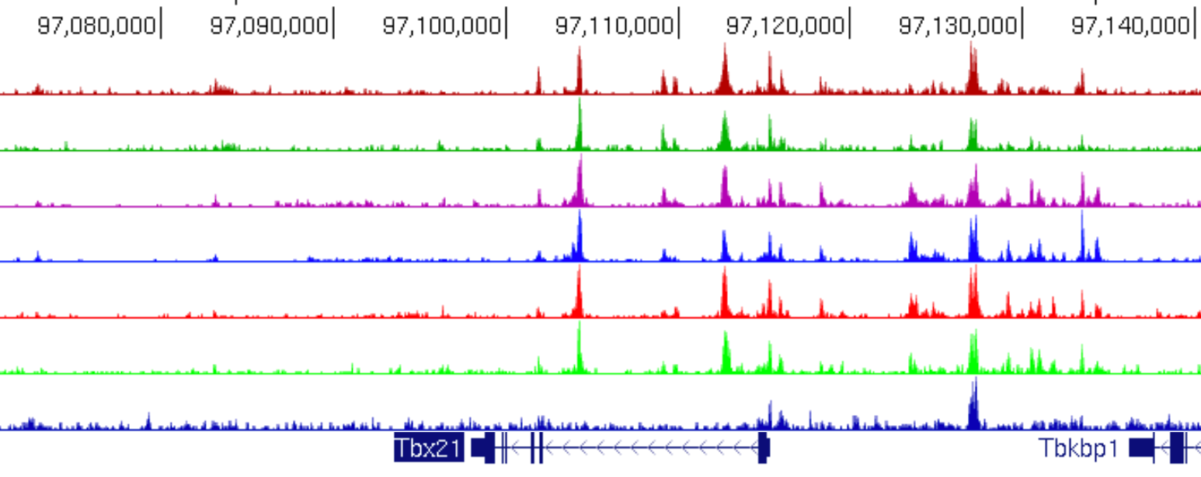
ATAC-Seq for Bcl6 / Prdm1 Deficient CD4 T Cells
SMARTA Cd4-Cre⁺ CD45.1⁺
LCMV
Armstrong
cells
Sort
ATAC-Seq
1. WT
2. Bcl6^{f/f}
3. Prdm1^{f/f}
4. Bcl6^{f/f}Prdm1^{f/f}
d-1
d0
d7
recipient
WT B6
WT
Bcl6^{f/f}
Prdm1^{f/f}
Bcl6^{f/f} Prdm1^{f/f}
Naïve SMARTA
SLAM
CD44
CXCR5
CD62L
10kb
Tbx21 expression
WT Tfh
Prdm1^{f/f} Tfh
WT Th1
Bcl6^{f/f} Th1
Bcl6^{f/f}Prdm1^{f/f} Th1
Bcl6^{f/f}Prdm1^{f/f} Tfh
Naive
BCL6 binding in human GC Tfh
Tbx21

Slide 27
Strategies for Identification of Potentially Important Bcl6 Target TFs in Tfh Differentiation
Bcl6
Group I
ATA-Seq
RNA-Seq
Bcl6-i genes
TFs
TFs
Th1⁺ genes
Tfh⁺ genes
Group IV
Bcl6-ii genes
TF-targeted genes
TF expression
Tfh function
PageRank
RNA-Seq
PageRank for Bcl6-ii genes
(Bcl6^{f/f} Prdm1^{f/f} Tfh vs Prdm1^{f/f} Tfh)
Group I TFs
(100 genes)
ChIP-Seq
p-value
60
Bcl6-i
TFs
Bcl6-target
genes
Human GC Tfh BCL6 ChIP-Seq
Mouse Bcl6 ChIP-Seq
Prdm1^{f/f} Tfh
Bcl6^{f/f} Prdm1^{f/f} Tfh
Strong candidate TFs that regulate Bcl6-ii genes

Slide 28
Effect of ΔBPS1 on Tfh Differentiation in Acute Virus Infection
BPS1 deletion in Bcl6 promoter by CRISPR/Cas9
WT mouse
Bcl6 Pro
+18, BPS1: TCTAGGAA
ΔBPS1 mouse
Bcl6 Pro
+18, ΔBPS1 (8 bp)
X
ΔBPS1
SMARTA CD45.1+
ΔBPS1 SMARTA CD45.1+
A novel mouse model with Bcl6 DNA-binding motif deletion in the Bcl6 promoter (ΔBPS1) were generated by CRISPR/Cas9 technique.

Slide 29
Proposed Auto-regulatory Mechanism of Bcl6 in Tfh Differentiation
Non-Tfh condition
Tfh condition
Blimp1
Bcl6
Bcl6
Bcl6
WT
TCTAGGAA
Bcl6
TCTAGGAA
Bcl6
Blimp1
Bcl6
Bcl6
ΔBPS1
Bcl6
Bcl6
Bcl6
ΔBPS1
ΔBPS1
Selplg,
Slamf1,
Tbx21
Cxcr5,
Pdcd1,
Btla,
Cd200

